Slide 1
Hardware Software Platforms Project Presentation
Smart Traffic Lights 2
FLAMENT Dorian - NGUYEN Thuy hai
Dorian.Flament@student.umons.ac.be
Thuy-hai.Nguyen@student.umons.ac.be
Notes:
Marine

Slide 2
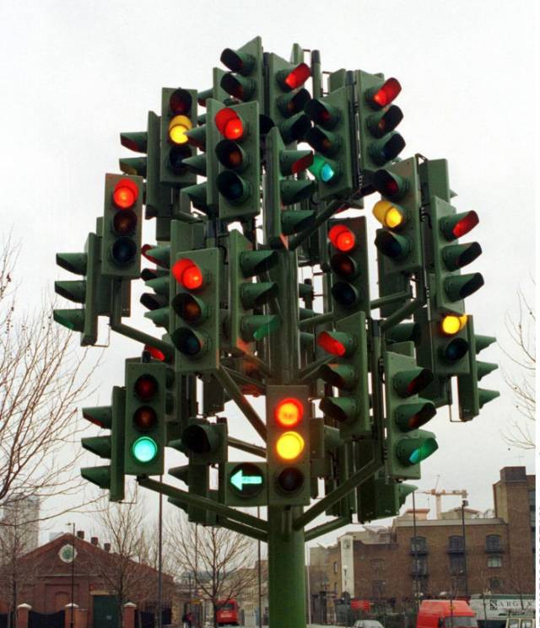
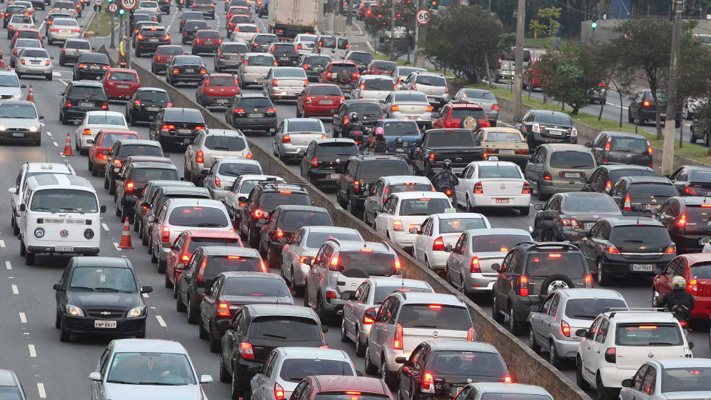
Introduction
What is the point of smart traffic lights ?
Pollution reduction
Time gain
Priority for emergency vehicles
Smart Traffic Lights 2 – FLAMENT Dorian & NGUYEN Thuy hai
Notes:
Marine
Dire que parfois il n’y a personne sur l’autre route, mais il faut attendre quand même. Pour les gros véhicules ça prend du temps et ça pollue de les faire démarrer, et en plus si c’est une ambulance ils doivent passer en priorité. S’il y a 10 voitures sur une voie et 1 sur l’autre, c’est mieux d’en arrêter qu’une pour l’environnement.

Slide 3
Tutorial version
Objectives
Detect cars on roads
Traffic lights control based on number of cars in each road
Smart Traffic Lights 2 – FLAMENT Dorian & NGUYEN Thuy hai
Notes:
Dorian

Slide 4
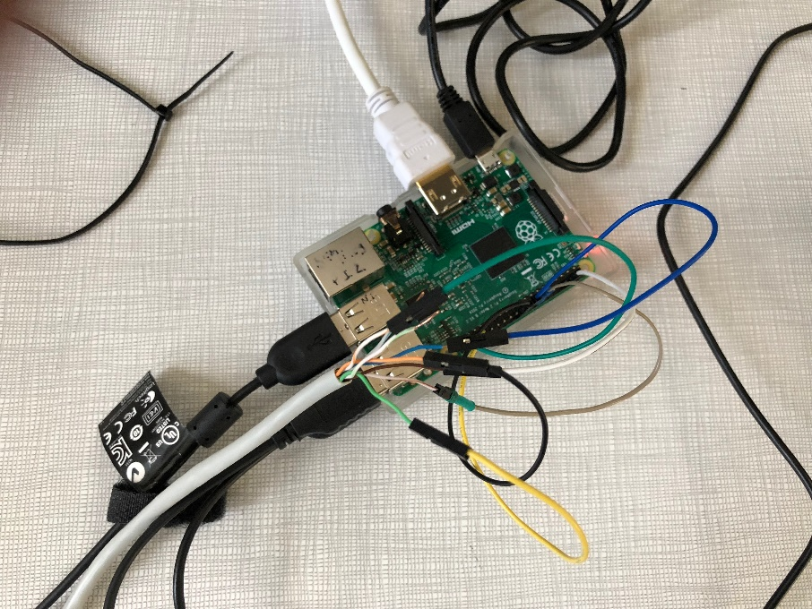
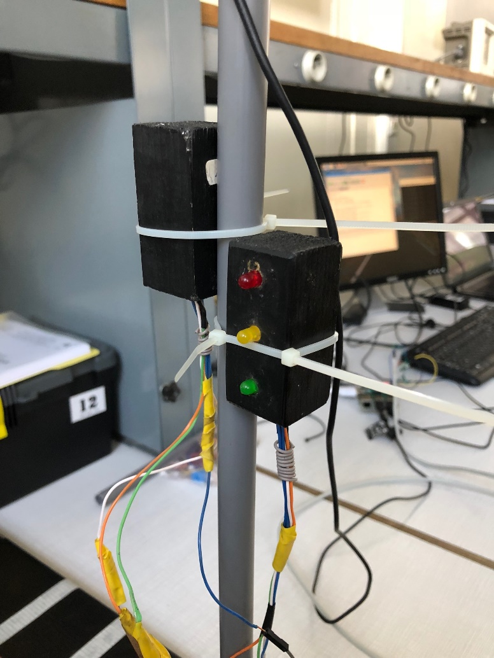
Components
Traffic Lights with LEDs
Raspberry PI
Manage cars detection
Manage cars counter
Send signals to leds
Smart Traffic Lights 2 – FLAMENT Dorian & NGUYEN Thuy hai
Notes:
Dorian

Slide 5
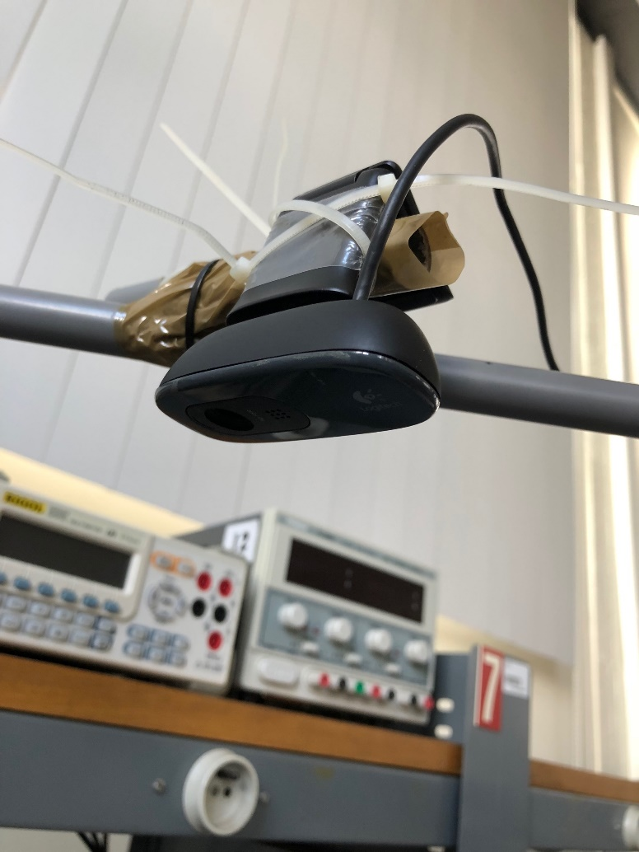
Components
In original tutorial, PiCamera
was used.
cam = PiCamera()
cam.resolution=(480,480)
cam.framerate=30
raw=PiRGBArray(cam, size=(480,480))
-> Code adapted to work with
any USB camera.
cam=cv2.VideoCapture(0)
cam.set(4,480) #Width=480
cam.set(5,480) #Height=480
cam.set(6,30) #FrameRate = 30
Webcam
Smart Traffic Lights 2 – FLAMENT Dorian & NGUYEN Thuy hai
Notes:
Dorian
Nous avons nous-mêmes modifié le code de base pour que ça marche avec une simple webcam usb

Slide 6



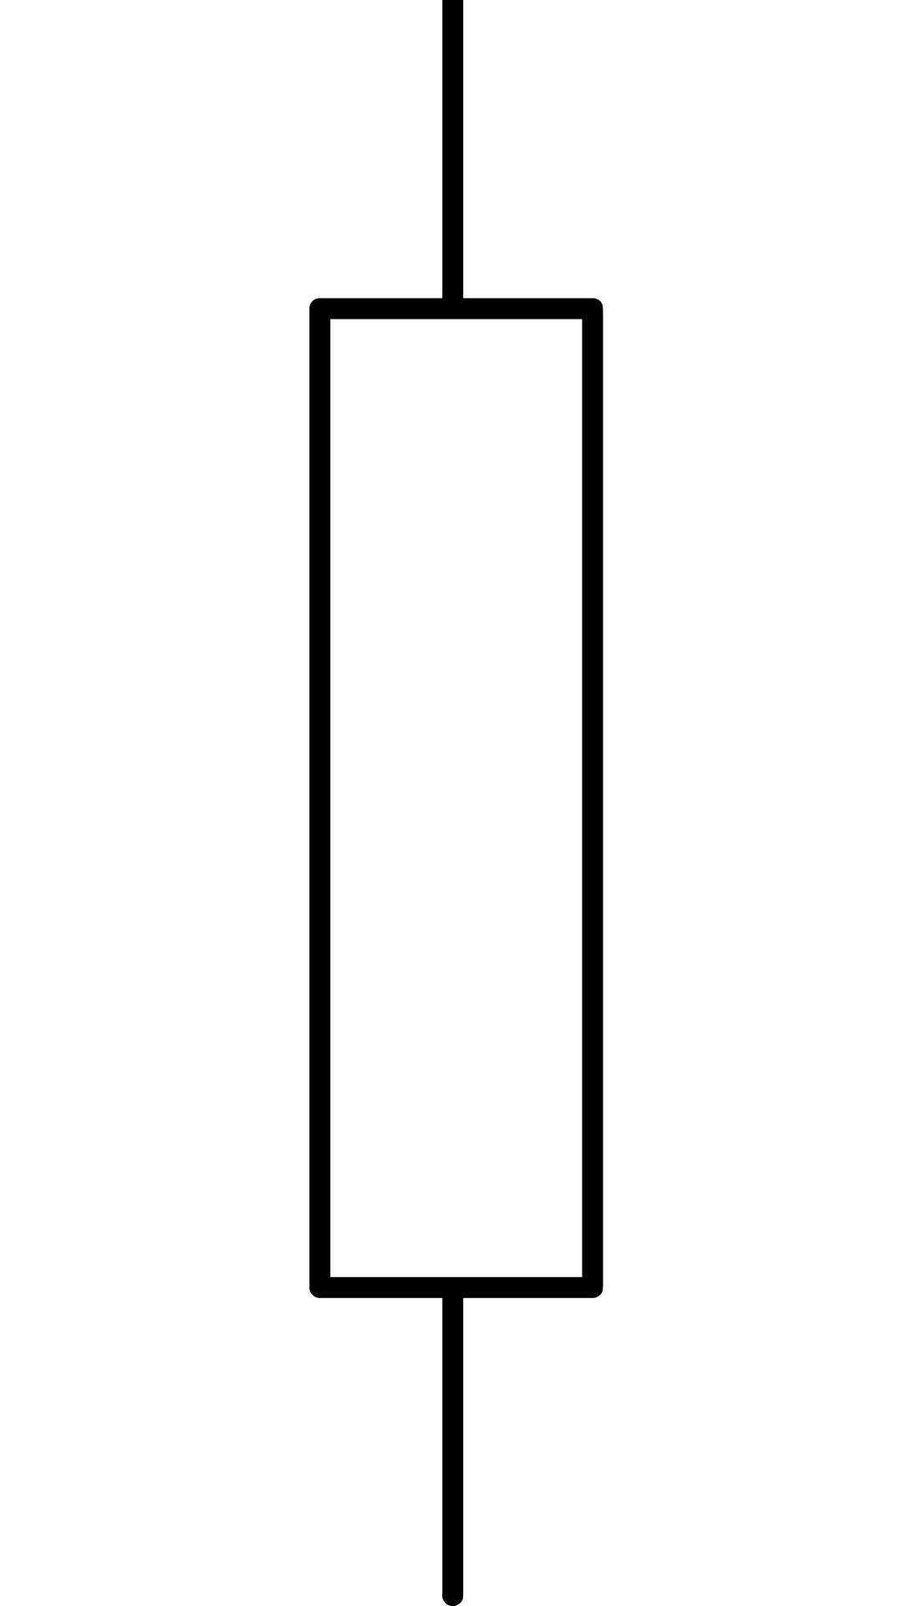
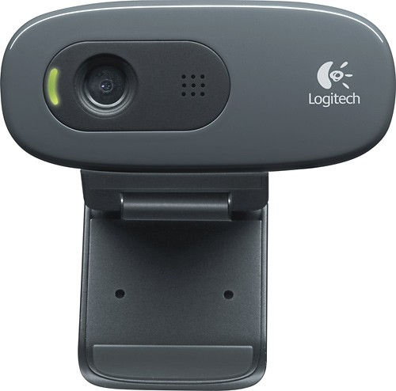
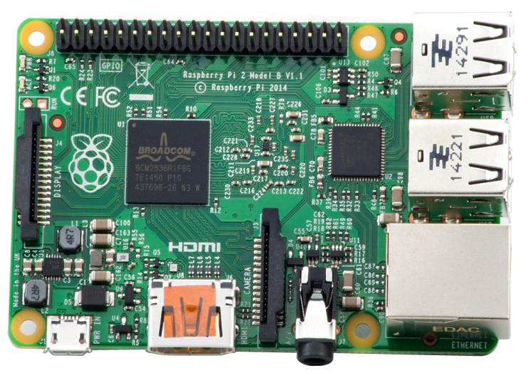
Components
Traffic light for vertical road
Traffic light for
horizontal road
82 Ω
82 Ω
82 Ω
82 Ω
Pin 25
Pin 23
Pin 16
Pin 21
USB
Smart Traffic Lights 2 – FLAMENT Dorian & NGUYEN Thuy hai
Notes:
Dorian

Slide 7
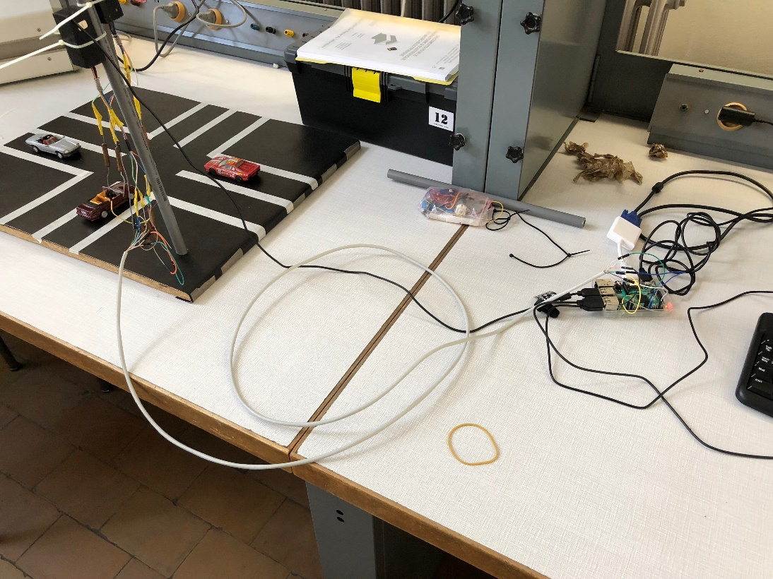
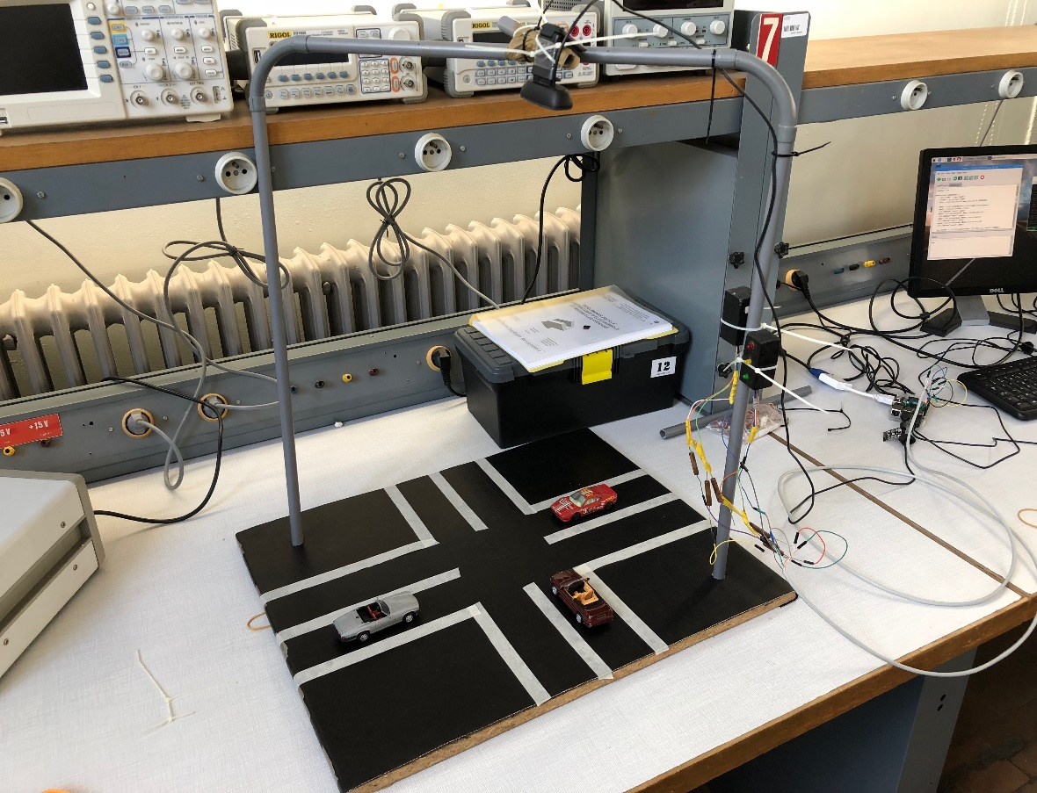
Global view
Webcam
Traffic Lights
Smart Traffic Lights 2 – FLAMENT Dorian & NGUYEN Thuy hai
Notes:
Dorian
On a construit nous-mêmes une structure pour pouvoir installer la webcam et tester le code.
On voit que les traffic lights et la webcam sont reliées à la Rpi, et à droite on place des voitures pour pouvoir tester.

Slide 8
Block diagram
Video stream from webcam
InitVert = 0
InitHor = 0
No
Is webcam working ?
Yes
Capture frame
Treatment
Find contours
Ncars
Counter and analysis
Show different streams
Yes
Stop key
No
Close all windows
Release webcam
Smart Traffic Lights 2 – FLAMENT Dorian & NGUYEN Thuy hai
Notes:
Marine

Slide 9
Block diagram
Counter and analysis
No
Car in vertical lane ?
Yes
Vert + 1
Vert
No
Car in horizontal lane ?
Yes
Hor + 1
Hor
Yes
Hor = InitHor ?
Vert = InitVert ?
No
Traffic lights don’t change
Yes
No
Vert < Hor ?
Green light for hor
Red light for vert
Green light for vert
Red light for hor
Yes
Car = Ncars ?
No
Smart Traffic Lights 2 – FLAMENT Dorian & NGUYEN Thuy hai
Notes:
Marine
Détails du bloc counter and analysis

Slide 10
Block diagram
Video stream from webcam
InitVert = 0
InitHor = 0
No
Is webcam working ?
Yes
Capture frame
Treatment
Find contours
Ncars
Counter and analysis
Show different streams
Yes
Stop key
No
Close all windows
Release webcam
Smart Traffic Lights 2 – FLAMENT Dorian & NGUYEN Thuy hai
Notes:
Marine

Slide 11
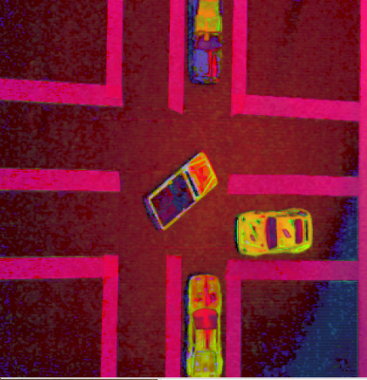
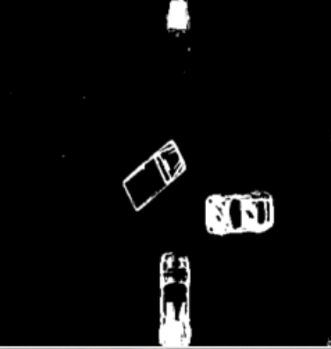




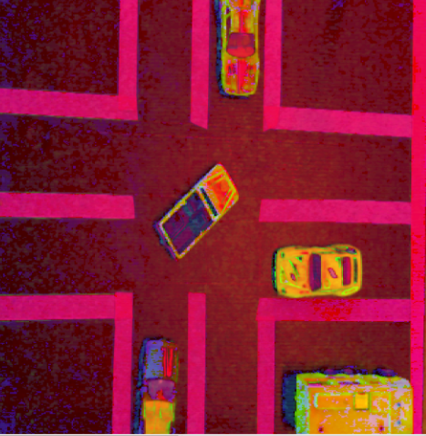

Frame treatment
Capture frame
Treatment
Library used: openCV (cv2)
Transform frame into array
Convert RGB to HSV
Threshold the HSV to exclude black and white
(road and strips)
4. Blur to ignore details
5. Dilate 10 times
6. Erode
7. Dilate 5 times
8. Threshold
Smart Traffic Lights 2 – FLAMENT Dorian & NGUYEN Thuy hai
Notes:
Dorian

Slide 12
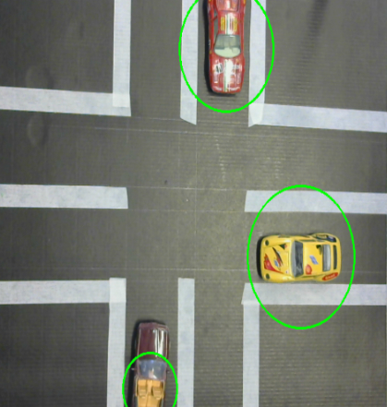
Find contours
Enclose vehicles with circle
Find radius and center
Coordinates of center are used to determine position on the road
Smart Traffic Lights 2 – FLAMENT Dorian & NGUYEN Thuy hai
Notes:
Dorian

Slide 13
Modifications
Original code was not working fine.
Some modifications made by us to improve the code :
Increase dilatation for detection to be adapted to all kind of cars
View of all different masks (blur, dilate, erode) to see different steps of detection
Put all masks in one window for more visibility
Correct limits of the road to be adjusted to our structure
Make code work for any USB webcam
Smart Traffic Lights 2 – FLAMENT Dorian & NGUYEN Thuy hai
Notes:
Dorian

Slide 14
Next step ?
Code could still be improved …
Smart Traffic Lights 2 – FLAMENT Dorian & NGUYEN Thuy hai
Notes:
Marine

Slide 15
Improved Version
Objectives
Give the priority to large vehicles like fire engines in order to manage emergency, decrease pollution and traffic jams
Automatic detection of road limits in order to adapt the system to all sizes of road of cross crossroads
Smart Traffic Lights 2 – FLAMENT Dorian & NGUYEN Thuy hai
Notes:
Marine

Slide 16
Improved Version
Block Diagram
Tutorial version algorithm is used
No
Detection of priority vehicle on a road
Calibration of the roads
Coordinates of the calibration objects detected
Limits of road detected
Yes
Green light for this road
Smart Traffic Lights 2 – FLAMENT Dorian & NGUYEN Thuy hai
Notes:
Marine

Slide 17
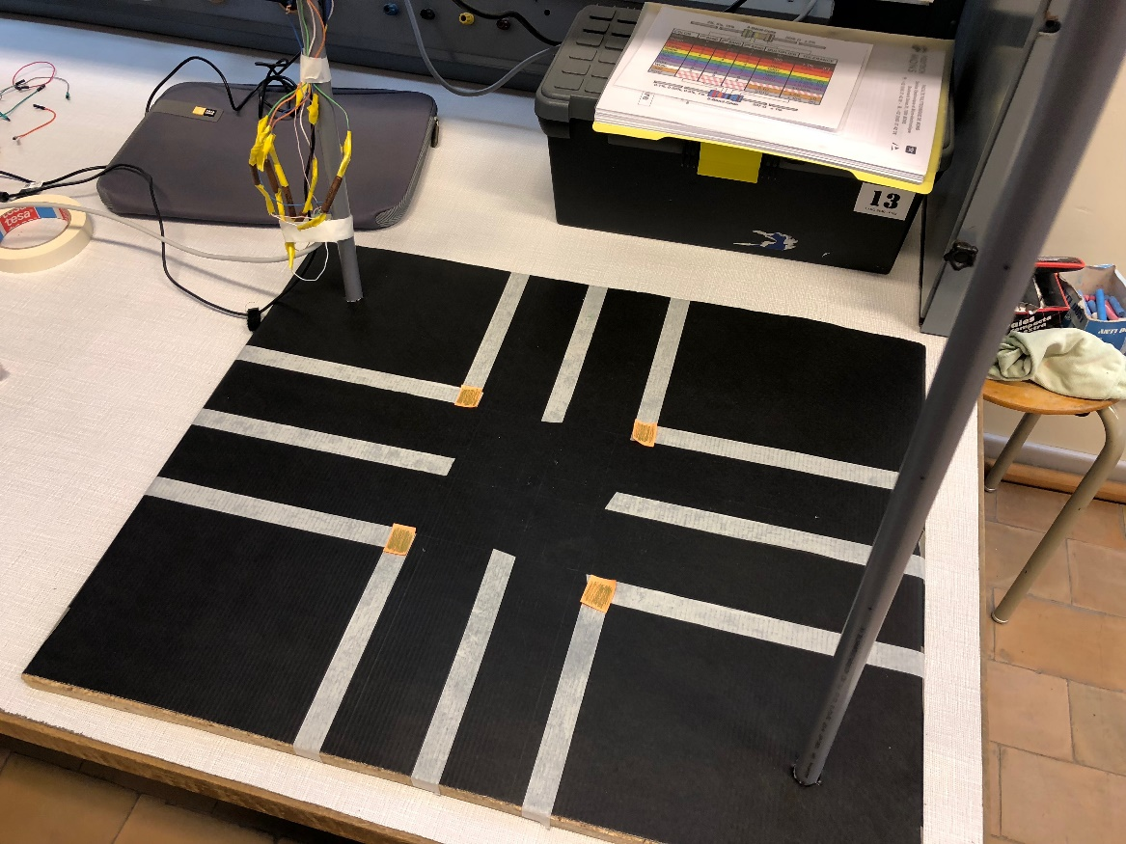
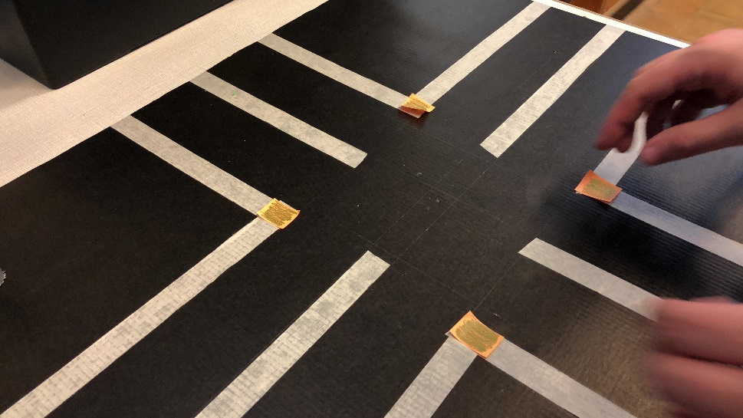
Improved Version 1
Improvement 1 : Automatic Calibration
Calibration objects to detect the coordinates of the crossroads limits
Smart Traffic Lights 2 – FLAMENT Dorian & NGUYEN Thuy hai
Notes:
Marine

Slide 18
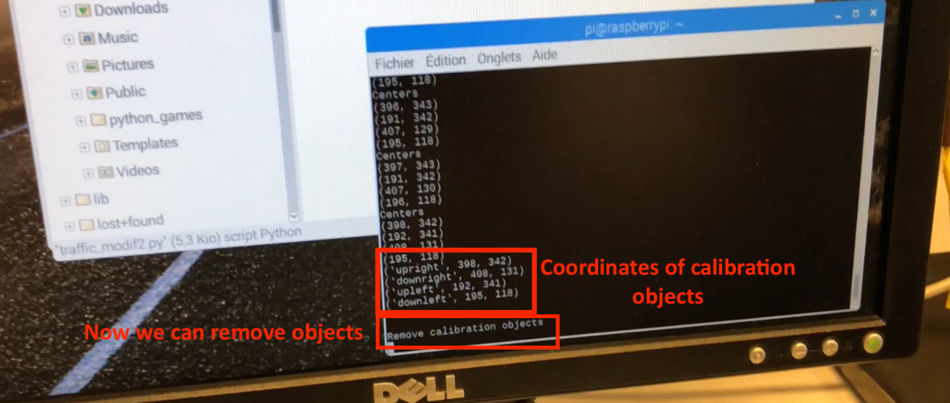
Improved Version 1
4 crossroads limits
Frame divided into 4 parts: each calibration object is
associated with a zone
Accurate calibration
Smart Traffic Lights 2 – FLAMENT Dorian & NGUYEN Thuy hai
Notes:
Marine
Détailler la calibration avec la position des plots dans chaque quartier (couper l’image en 4)
Associer un carré jaune à un des coins du carrefour
On obtient 4 coins.
Détection précise car coordonnées correspondantes sont quasi égales

Slide 19
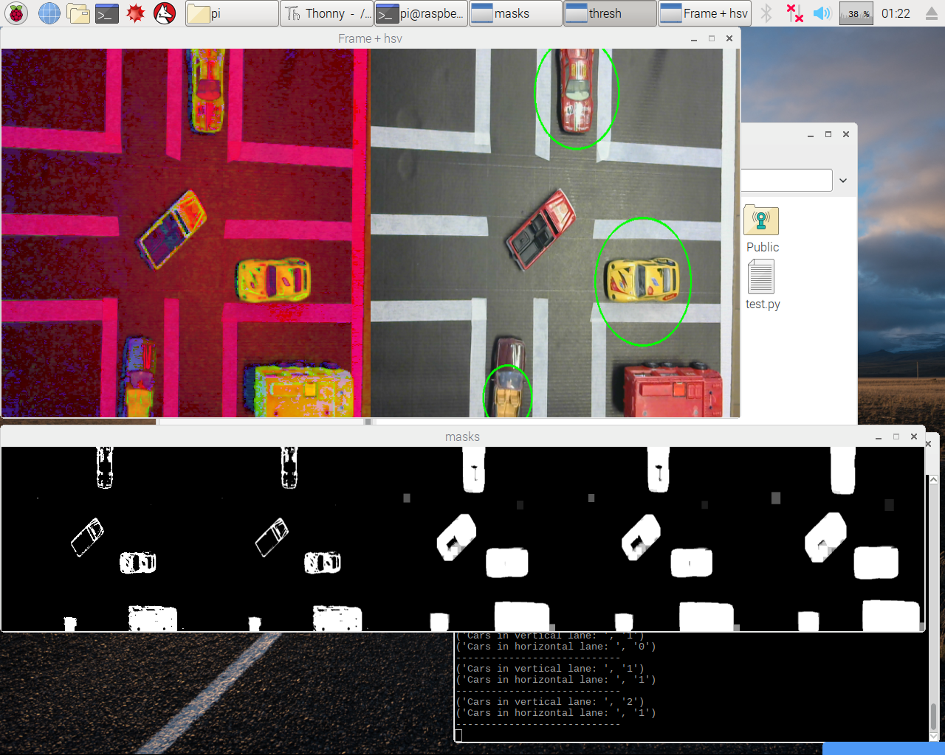
Improved Version 1
Correct calibration: vehicles in crossroads and outside
road limits are not taken into account
Smart Traffic Lights 2 – FLAMENT Dorian & NGUYEN Thuy hai
Notes:
Marine

Slide 20
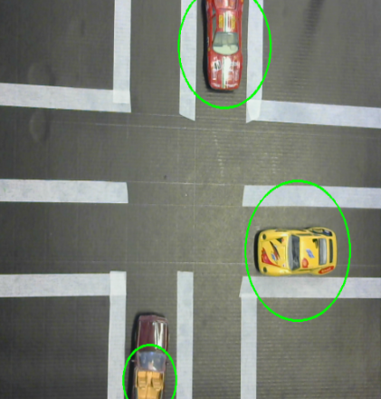
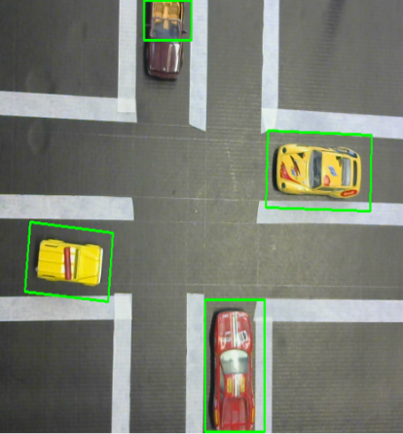
Improved Version 2
Originally
Improved
Improvement 2 : Priority vehicles
Rectangle are used to frame : more accurate to detect the size of a vehicle -> area of rectangle is calculated to determine size
Smart Traffic Lights 2 – FLAMENT Dorian & NGUYEN Thuy hai
Notes:
Dorian

Slide 21
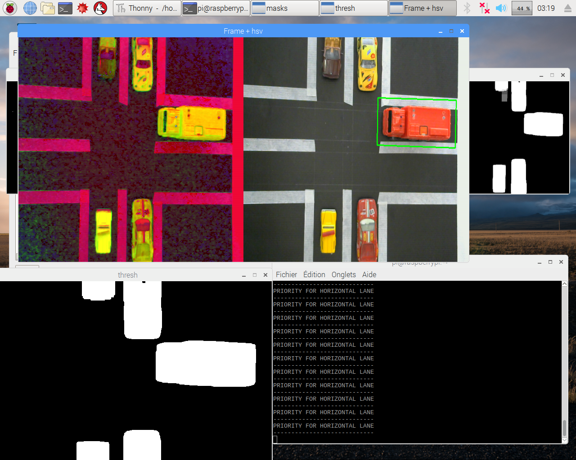
Improved Version 2
Improvement 2 : Priority vehicles
When a large vehicle appears on a road
(area > threshold) :
The other vehicles are not counted
Green light for this road
Smart Traffic Lights 2 – FLAMENT Dorian & NGUYEN Thuy hai
Notes:
Dorian

Slide 22
Prospect of improvement
What could be even more improved:
Adaptation to more complex crossroads
Priority for emergency vehicles over priority for trucks (specific colors)
Smart Traffic Lights 2 – FLAMENT Dorian & NGUYEN Thuy hai
Notes:
Dorian

Slide 23
Project presentation video
Youtube links:
Base tutorial:
https://www.youtube.com/watch?v=jQJlSoAfE3g&t=25s
Improved version 1:
https://www.youtube.com/watch?v=-3C68o-8WWs&t=21s
Improved version 2:
https://www.youtube.com/watch?v=j2LM9ZPuFI4
Smart Traffic Lights 2 – FLAMENT Dorian & NGUYEN Thuy hai
Notes:
Dorian

Slide 24
Useful links
Youtube channel:
https://www.youtube.com/channel/UCRLHQksECPiZ9VwZONcNINQ
Base tutorial:
http://www.instructables.com/id/Smart-Traffic-Light/
GitHub
https://github.com/Twitwi96/Smart-traffic-light-2
Smart Traffic Lights 2 – FLAMENT Dorian & NGUYEN Thuy hai
Notes:
Dorian
Remercier pour l’attention
Dire qu’on va montrer une vidéo

Slide 25
Thank you for your attention !
Smart Traffic Lights 2 – FLAMENT Dorian & NGUYEN Thuy hai
Notes:
Dorian
Remercier pour l’attention
Dire qu’on va montrer une vidéo

